Slide 1
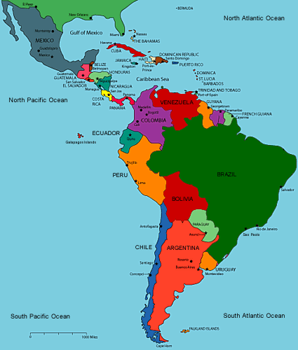

State of Intercultural in Latin America
“Interculturality, the preferred term in Latin America, refers to a historic condition, a radical restructuring of the historically uneven relations of wealth and power that have existed between Europeans and their descendants and indigenous and other subordinated groups during the last half millennium. The aim is decolonization of institutions and the sociocultural fabric of the country.”
— A. Medina-López-Portillo and John H. Sinnigen, “Interculturality vs. Intercultural Competencies in Latin America,”
in Deardorff 2009, Sage Handbook of Intercultural Competence
11 countries in Latin America include the multicultural and multilingual nature of their nations in their constitutions. Which are they?
4 other countries in this region recognize indigenous rights.
Which are they?
515 million people in Latin America. 37 million indigenous (7%).
FIVE countries are home to 90% of the indigenous population.
Which 5?
Notes:
[10:55-11]
In closing I want to spend just 10 minutes talking about something bigger than each of you as individuals.
11 nations: Argentina, Bolivia, Brazil, Colombia, Ecuador, Guatemala, Mexico, Nicaragua, Paraguay, Perú, Venezuela
4 other nations: Chile, El Salvador, Honduras, Panama
Which 5?
Perú – 27%
México – 26%
Guatemala – 15%
Bolivia – 12%
Ecuador – 8%
As opposed to US monolingual and ethnocentrism
Talk a bit of history, colonization
Evo Morales, Bolivia, Aymara (2005)
Rafael Correa, Ecuador, mestizo (2006)

Slide 2
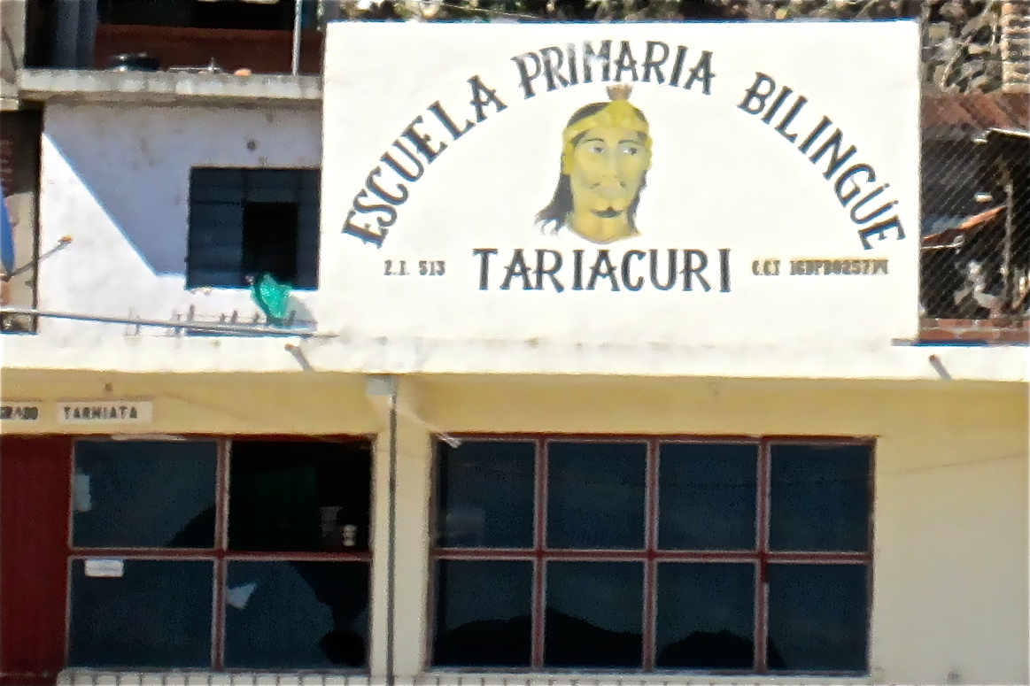
State of Intercultural
in Latin America
Much to learn from Latin American interculturality:
Counter-hegemonic; focus on the balance of power
Starts with the needs of marginalized cultures (diverse indigenous movements from Mexico to Bolivia and Ecuador)
Advocates mutual respect and economic and political equality rather than the acculturation of the oppressed
Incorporates Andean/Amazonian concepts such as respect for Pachamama, good living, communitarian practices
Multilingual integration
Decades of dialogue leading to constitutional specificity
From A. Medina-López-Portillo and John H. Sinnigen
“Interculturality vs. Intercultural Competencies in Latin America,”
in Deardorff 2009, Sage Handbook of Intercultural Competence
Notes:
[11-11:05]
Amy Chua, World on Fire
Pachamama is supreme goddess of Aymara and Quechua
Good living = alli kawsay in Ecuador, suma gamaña in Bolivia
Harmonious living = ñandereko in Bolivia

Slide 3
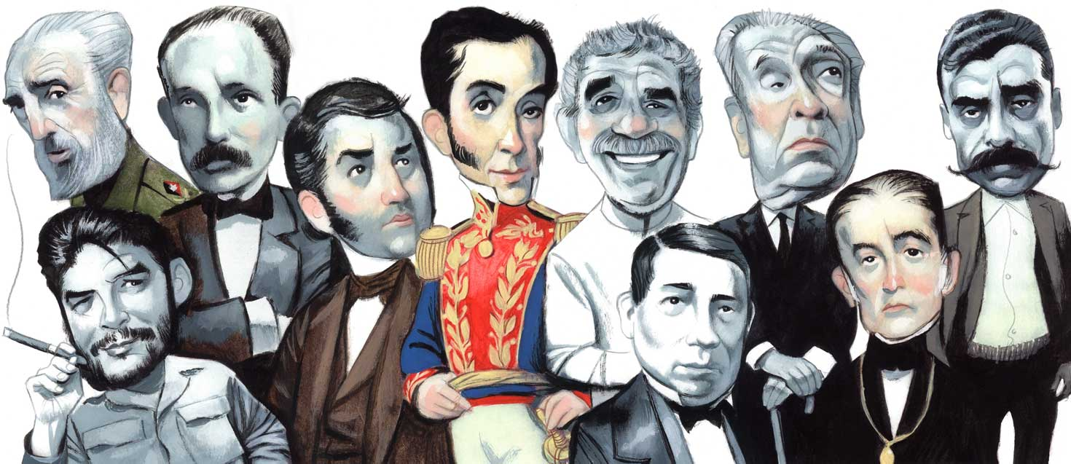
State of Intercultural in Latin America
Stages of National Identity Creation in Latin America
Foundational/Independence (1810-1840 intense): build, educate and civilize nation-states by the elites and the state
Integrative (1890-1920): integrate new social and ethnic sectors, expand state services, link nation to the idea of mestizaje
Revolutionary (1950-1975): transform the socioeconomic structures to benefit workers and the poorest, link the concept of nation to social class and anti-imperialism
Globalized (started 1980s): nation-states to enter the globalization stage while keeping their identity in a context of cultural diversity
Strengthening of national-ethnic-cultural identities has to occur simultaneously to the intercultural dialogue as identities are created in relation to the “other.”
— F. Tubino, “La praxis de la interculturalidad en los estados nacionales latinoamericans,” Cuadernos Internacionales, 3(5), pp. 83-96, 2005.
From A. Medina-López-Portillo and John H. Sinnigen
“Interculturality vs. Intercultural Competencies in Latin America,”
in Deardorff 2009, Sage Handbook of Intercultural Competence
Notes:
[11:05-11:10]
Back to 3 competencies
Monday, 30 November 2009 Latin American History Makers
The ever excellent weekly literary supplement Babelia in El País (Cadíz, Spain) is devoted this week to Latin America. As part of its special edition it asked 100 Latin American personalities to choose the ten hispanoamericanos who have most marked the last 200 years of Latin American history. The participants included a diverse list of politicians, academics, writers, scientists, artists, musicians, etc. from the full range of hispanoamericano countries. The top ten figures were:
Simón Bolívar
Fidel Castro
Che Guevara
José Martí
José de San Martín
Benito Juárez
Jorge Luis Borges
Gabriel García Márquez
Emiliano Zapata
Andrés Bello
Missing: Hugo Chavez, Evo Morales
I was amazed, but delighted, to see Fidel Castro and Che Guevara coming in at numbers 2 and 3. Intellectual life in Latin America is clearly very different to that in Europe or North America. You can find who voted for who here:http://www.elpais.com/elpaismedia/ultimahora/media/200911/28/cultura/20091128elpepucul_1_Pes_PDF.pdf

